Slide 1
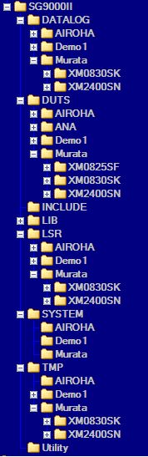
SG9000 Directory

Slide 2
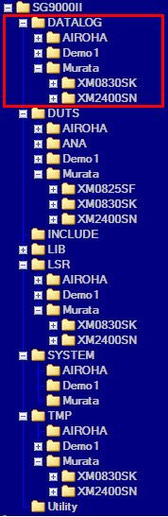
SG9000 Directory
Datalog
  --Customer
    --DUT Name
      – MP/GS/QC
The data-log files like as “xls”, “stdf”, “txt” were put in here.

Slide 3
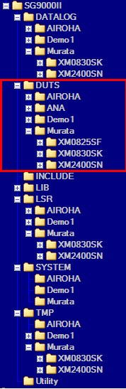
SG9000 Directory
DUTs
  --Customer
    --DUTName
The Peoject files for DUT were put in the “DUTS” directory

Slide 4
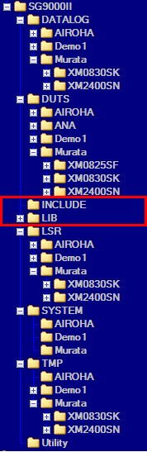
SG9000 Directory
“INCLUDE”
  The files in this directory are included for OS.
“LIB”
  The library files are put in the directory for test program.

Slide 5
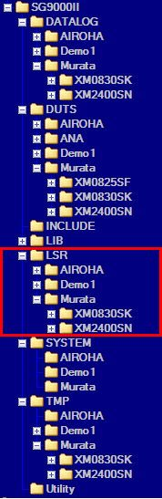
SG9000 Directory
LSR
  --Customer
    --DUTName
      – MP/GS/QC
LSR files generated by OS were put in this directory.

Slide 6
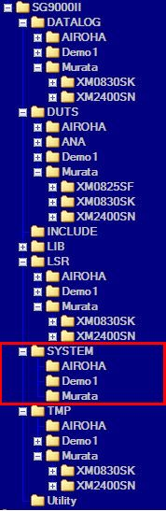
SG9000 Directory
SYSTEM
  --Customer
The files that used for auto-transform, SQC rules, lot name checked are put in this directory.

Slide 7
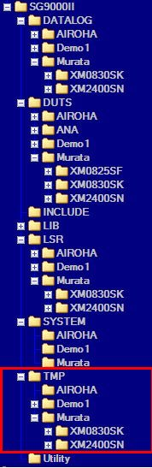
SG9000 Directory
TMP
  --Customer
    --DUTName
      --MP/GS/QC
Temperary files that record summary about LSR were put

Slide 8
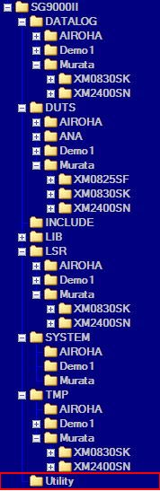
SG9000 Directory
Utility
The program like as self-diagnose, path-calibration; were put in this directory.

